Slide 1

OpenMBEE and the Lifecycle Change Process
Dec 6, 2016, Robert Karban, Marie Piette, Ivan Gomes, Chris Delp
Jet Propulsion Laboratory,
California Institute of Technology

Slide 2
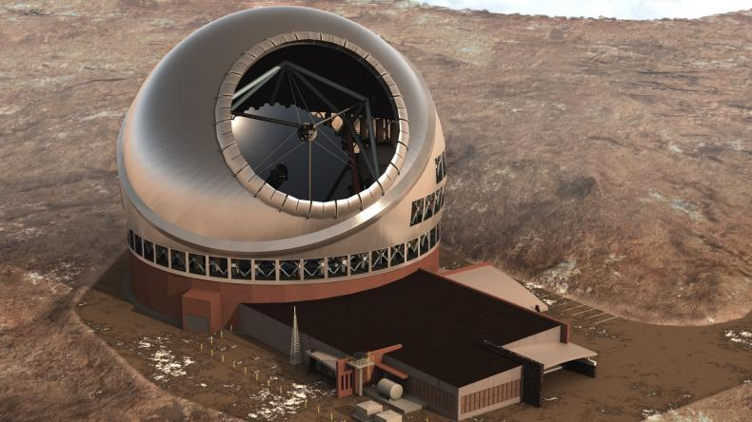
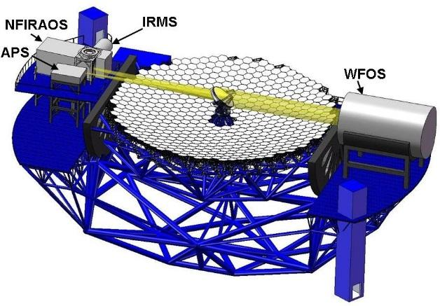
Thirty Meter Telescope (TMT) www.tmt.org
Developed by TMT International Observatory (TIO)
JPL participates in several subsystems of TMT
APS (and AO) team uses MBSE to analyze requirements, produce design, and perform analysis
Alignment and Phasing System (APS)
Sensor responsible for measuring the pre-adaptive optics wavefront quality

Slide 3
TMT MBSE Objectives
Use MBSE to define executable SysML model that captures requirements, operational scenarios (use cases), system decomposition, relationships and between subsystems, etc.
Use the model to analyze the system design for
power consumption, mass, and duration
Produce engineering documents
Requirement Flow Down Document
Operational Scenario Document
Design Description Document
Interface Control Documents
Uses standard languages and techniques where practical to avoid custom software development

Slide 4
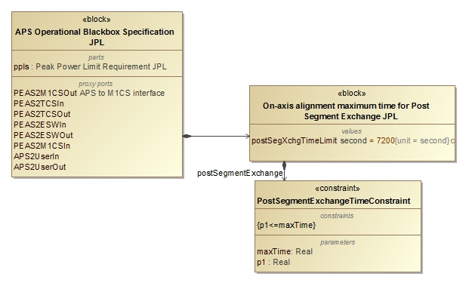
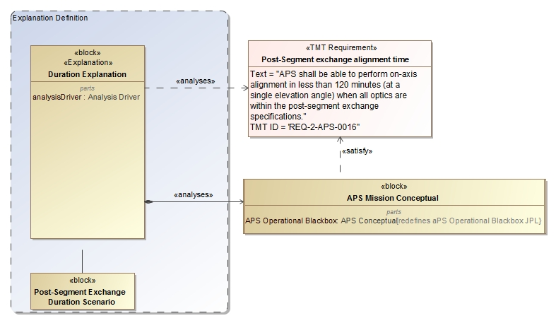
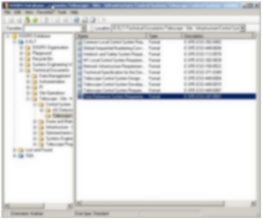
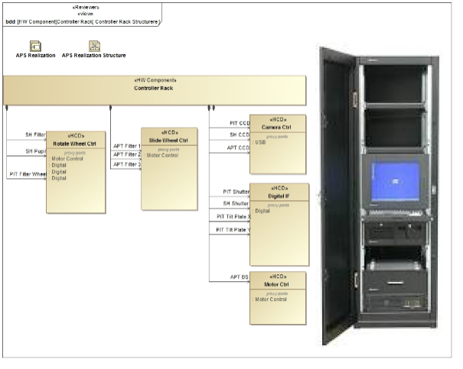
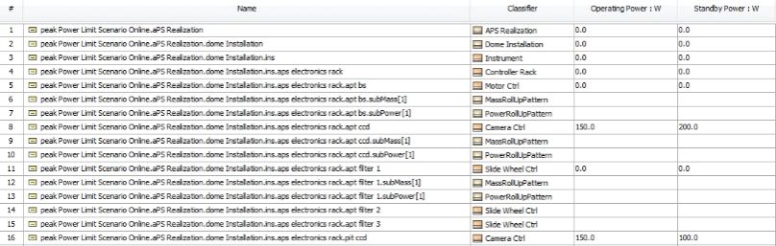
Analysis of Architecture and Design
Update Requirements
Analyze Conceptual Design
2
4
3
Analyze Realization Design/Specification
5
1
Max duration Post-segment exchange: 7200s 5000s
Number of exposures of 45s 4 6
Max peak power consumption in dome: 8.5kw 8.1kw Number of motors with 50W 10 12
6
Pass/fail
OCD, Requirements, ICD, DDD
Notes:
Touches on all modeling capabilities: construction, visualization, analysis, management, exchange and integration, collaboration and workflow

Slide 5
OpenMBEE https://github.com/Open-MBEE
Provides a platform for modeling that integrates JPL’s mission environment OpenCAE, by incorporating a model repository that can be accessed for example with a rich SysML desktop client (MagicDraw) and a light-weight web-based client (ViewEditor)
The model repository provides the following features:
Basic Infrastructure for Version, Workflow, Access Control
Flexibility of content
Support for Web Applications and Web-based API access
Multi-tool and multi-repository integration across engineering and management disciplines

Slide 6
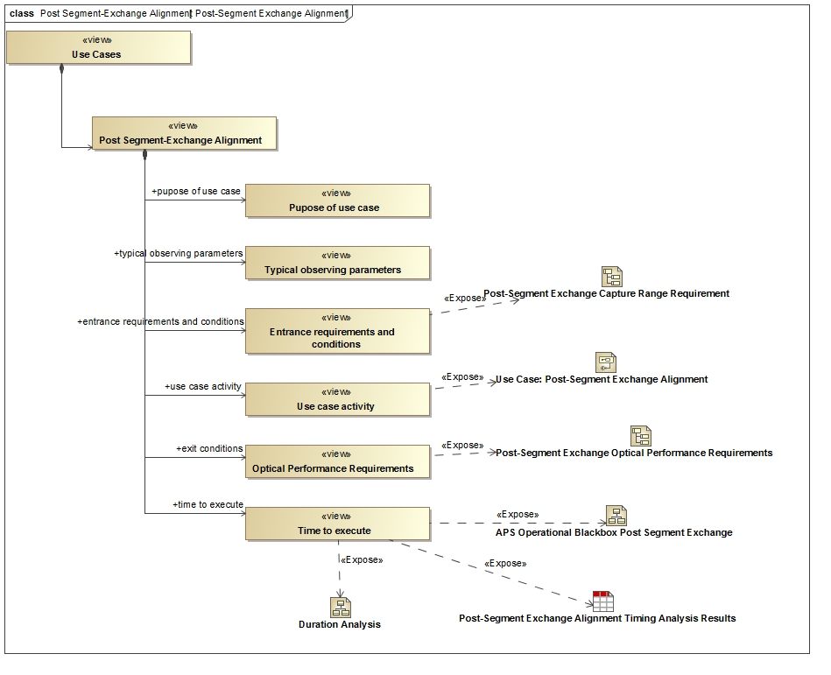
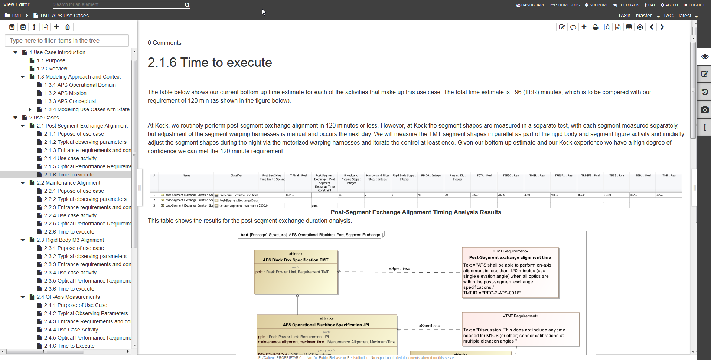
OpenMBEE Core Integration
Model of Document in
MagicDraw/Model Development Kit
MMS repository
Rendered and editable document in Web interface View Editor

Slide 7
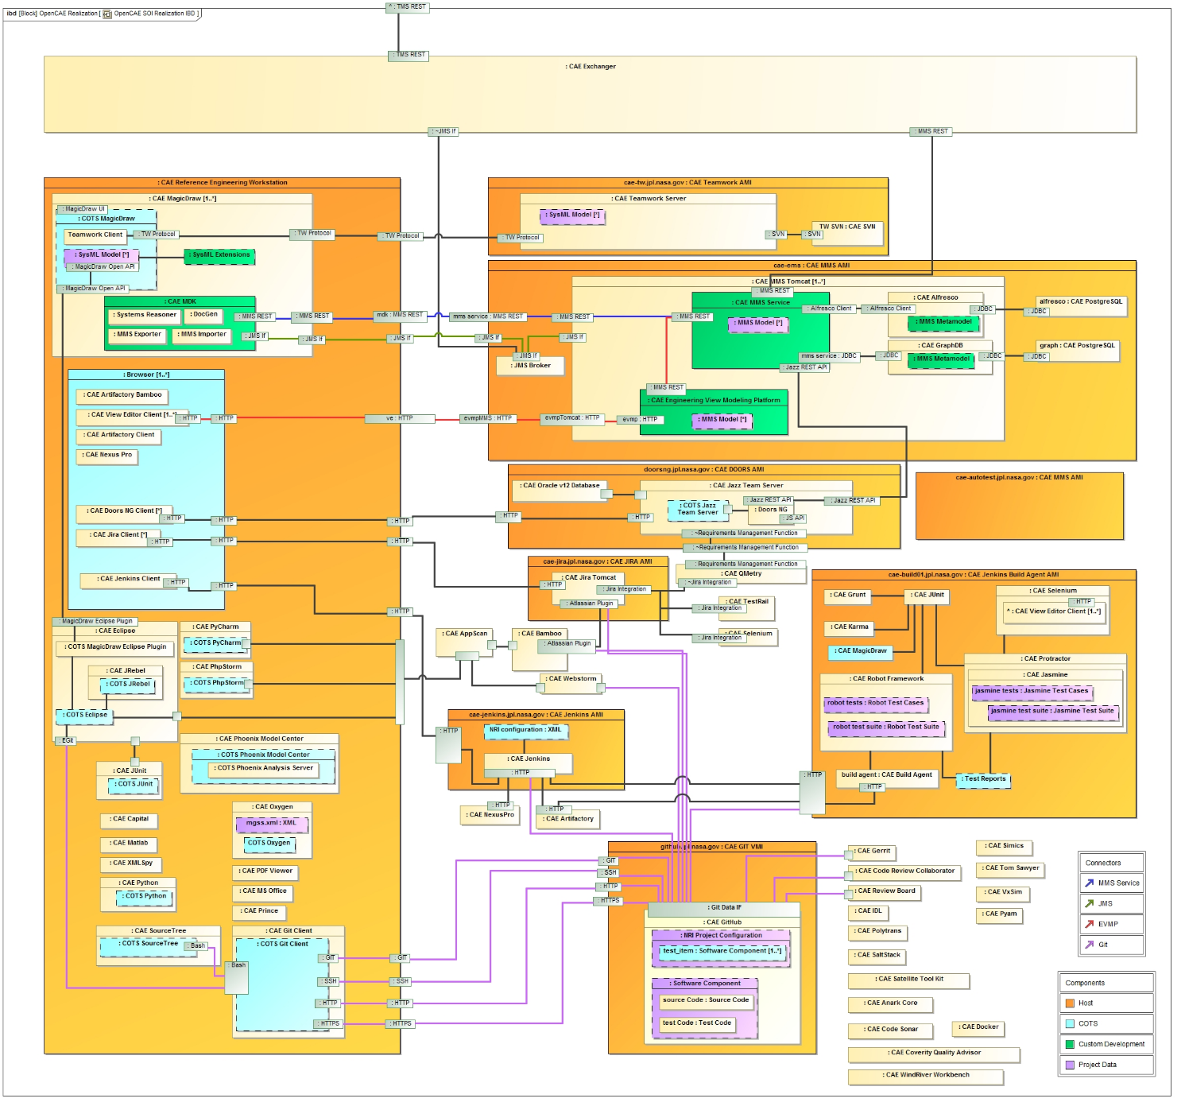
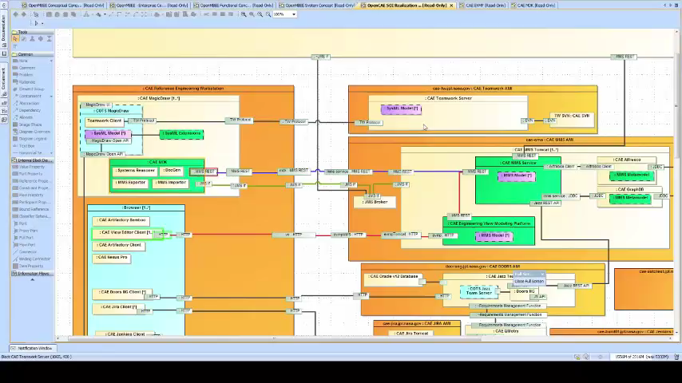
OpenMBEE Current Realization
Notes:
simulation

Slide 8
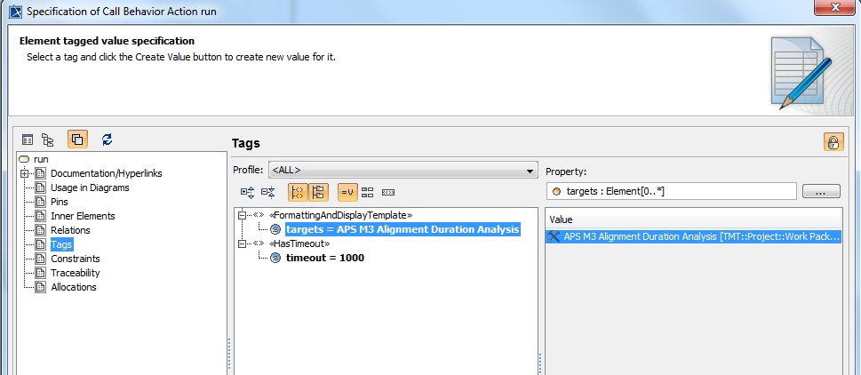
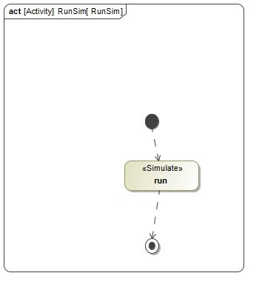
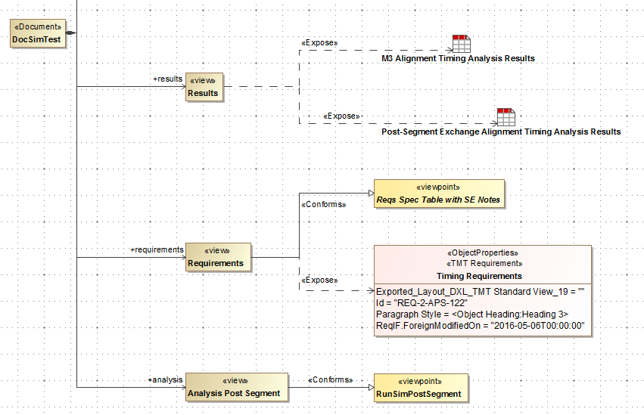
Automated Analysis with docgen

Slide 9
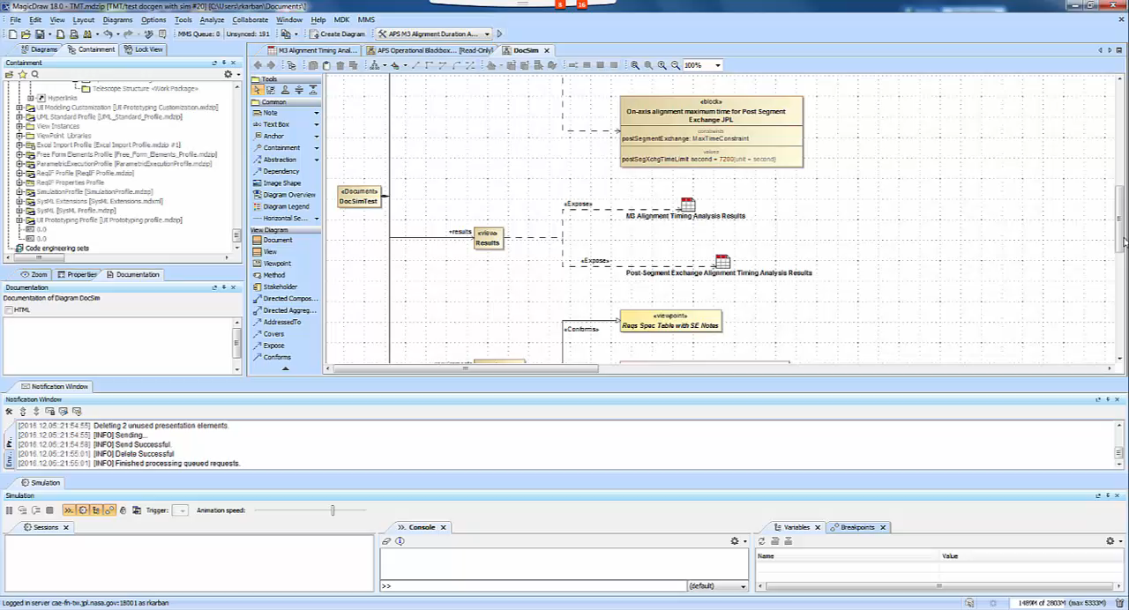
Automated Analysis with docgen

Slide 10
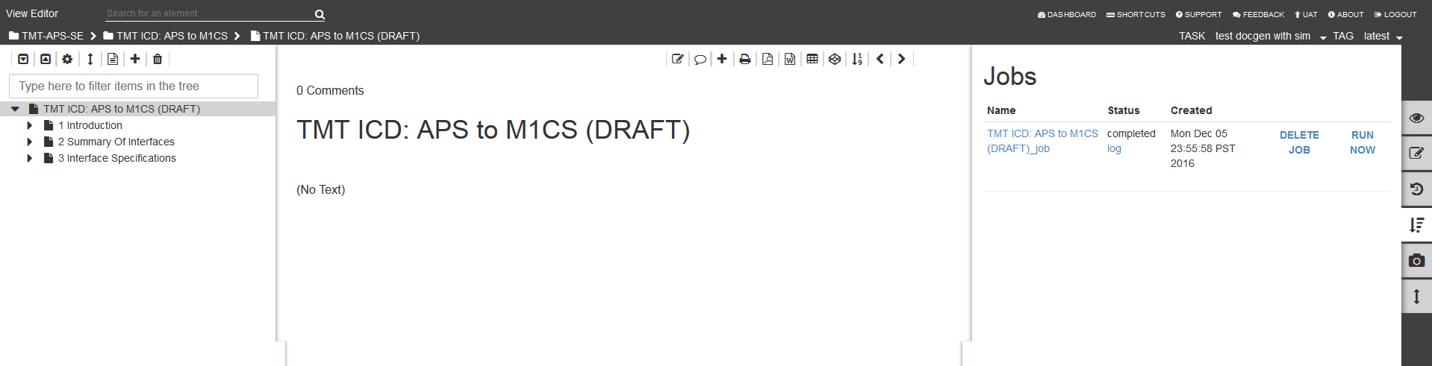
Platform for Model Analysis (PMA)
Schedule a analysis job integrated with document generation from View Editor

Slide 11
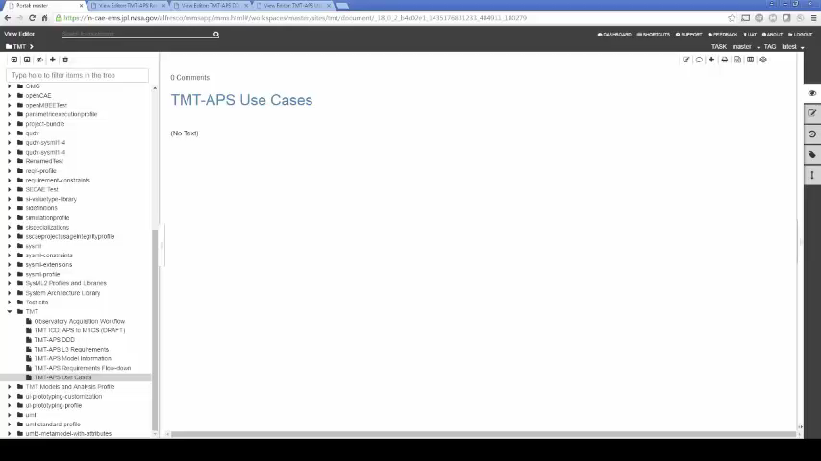
System Level Analysis

Slide 12
Acknowledgments
The research was carried out at the Jet Propulsion Laboratory, California Institute of Technology, under a contract with the National Aeronautics and Space Administration and NoMagic.
The TMT Project gratefully acknowledges the support of the TMT collaborating institutions. They are the Association of Canadian Universities for Research in Astronomy (ACURA), the California Institute of Technology, the University of California, the National Astronomical Observatory of Japan, the National Astronomical Observatories of China and their consortium partners, and the Department of Science and Technology of India and their supported institutes. This work was supported as well by the Gordon and Betty Moore Foundation, the Canada Foundation for Innovation, the Ontario Ministry of Research and Innovation, the National Research Council of Canada, the Natural Sciences and Engineering Research Council of Canada, the British Columbia Knowledge Development Fund, the Association of Universities for Research in Astronomy (AURA) and the U.S. National Science Foundation.

